Slide 1
Key Principles and Concepts Required to Navigate Your Dairy and Feed Markets” Carl Babler
16 January, 2023

Slide 2
Risk Disclosure
Risk in purchasing options is the option premium paid plus transaction. Selling futures and/or options leaves you vulnerable to unlimited risk. Atten Babler Commodities LLC uses sources that they believe to be reliable, but they cannot warrant the accuracy of any of the data included in this report. Past performance is not indicative of future results. Unless otherwise stated the information contained herein is meant for educational purposes only and is not a solicitation to buy futures or options.
Transaction Cost used throughout this presentation is commission plus fees.
For customers trading options, these futures charts are presented for informational purposes only. They are intended to show how investing in options can depend on the underlying futures prices; specifically, whether or not an option purchaser is buying an in-the-money, at-the-money, or out-of-the money option. Furthermore, the purchaser will be able to determine whether or not to exercise his right on an option depending on how the option’s strike price compares to the underlying future’s price. The futures charts are not intended to imply that option prices move in tandem with futures prices. In fact, option prices may only move a fraction of the price move in the underlying futures. In some cases, the option may not move at all or even move in the opposite direction of the underlying futures contract. The author of this piece currently hedges for his own account and has financial interest in the following derivative products mentioned within: corn, soybean, lean hogs and natural gas.

Slide 3
Thank You

Slide 4
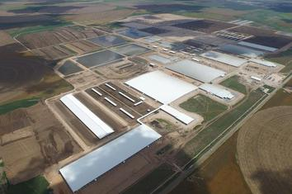
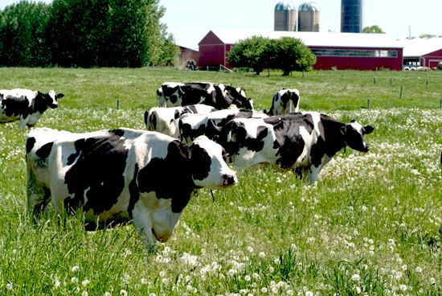
Dairy Producer Opportunities I see….
Product “Milk”
Commodity
“MILK”

Slide 5
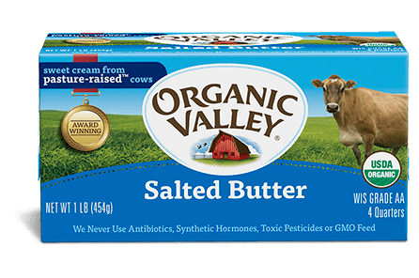
Dairy Food Chain Commodity/Product, Producer/Processor Divide
Various Scales, Aligned Fresh, Local, Organic, Non-GMO Products
X
Traditional Commodity Based System Family Farm
Large Scale, Concentrated, Destination, GMO Commodities

Slide 6
Agenda
4 Keys Principles and Concepts Required…
1. Understanding Price
2. Price has reoccurring Behavior
3. Price is the focus of Marketing
4. Identify Price Risk first step in Marketing
Plus: The Observed Characteristics of a Successful Marketer

Slide 7
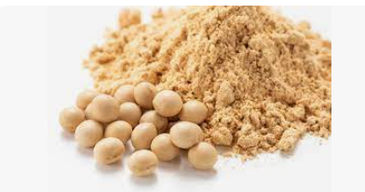
Commodity Prices you Care About

Slide 8
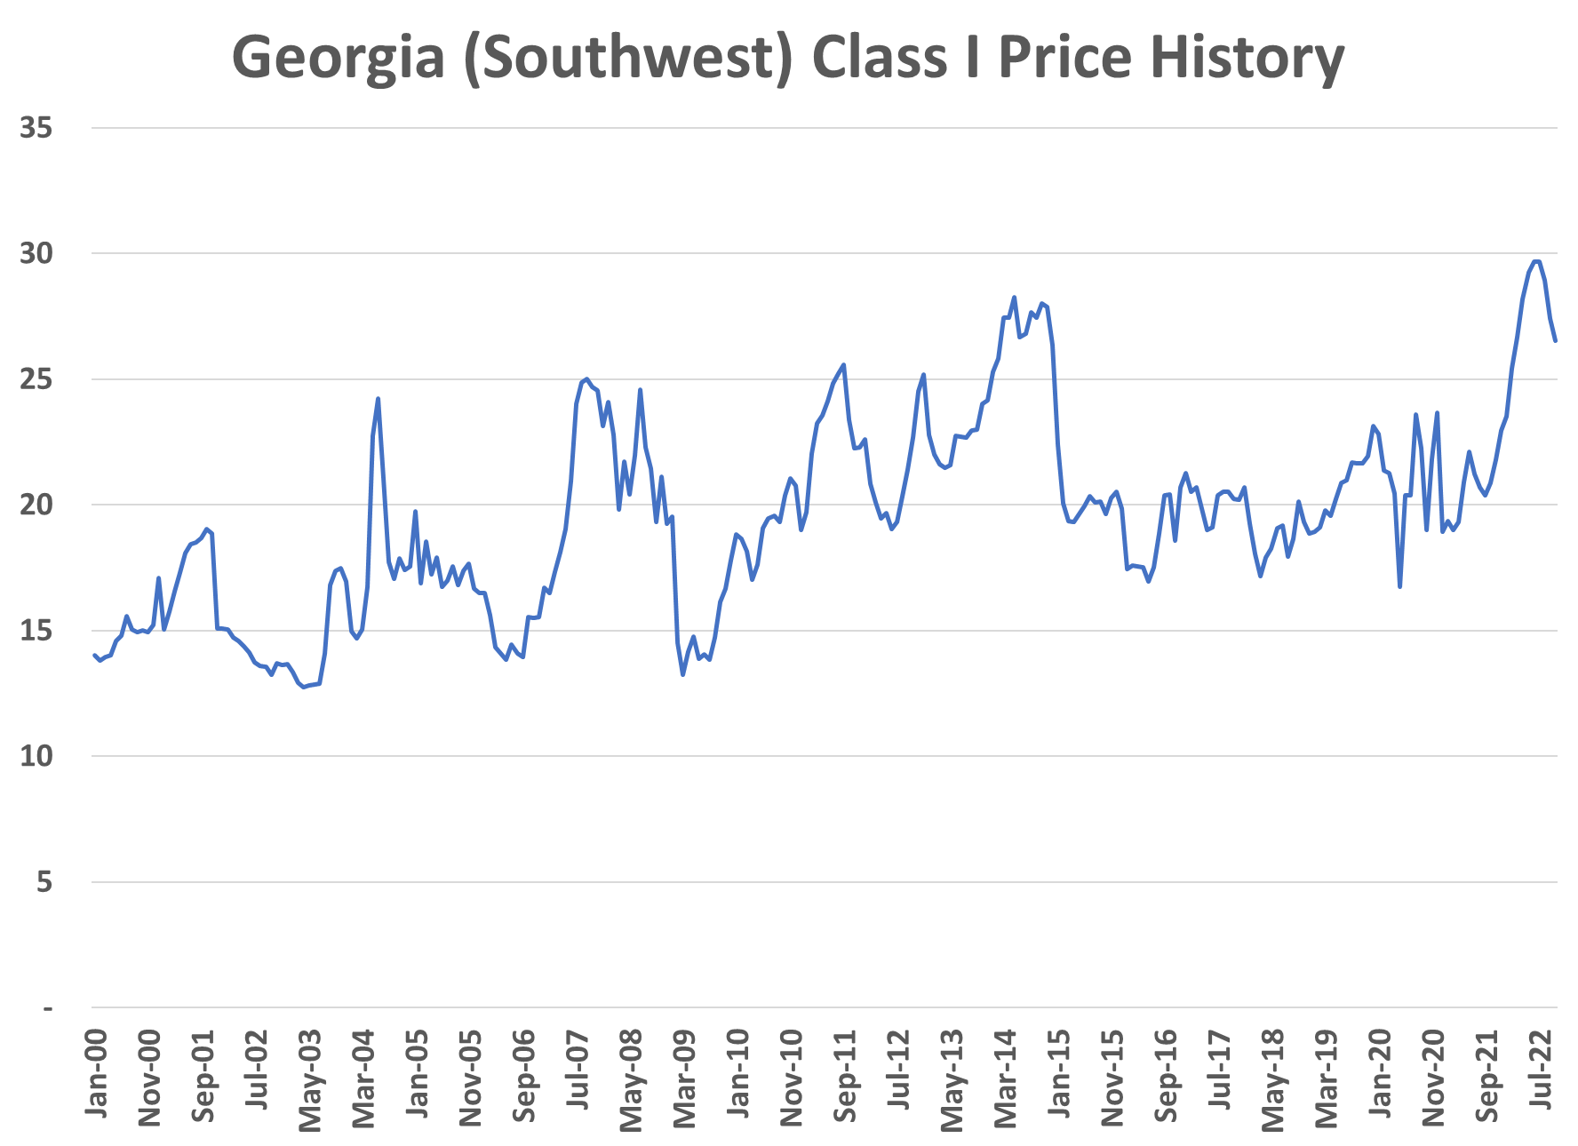
Source:FutureSource

Slide 9
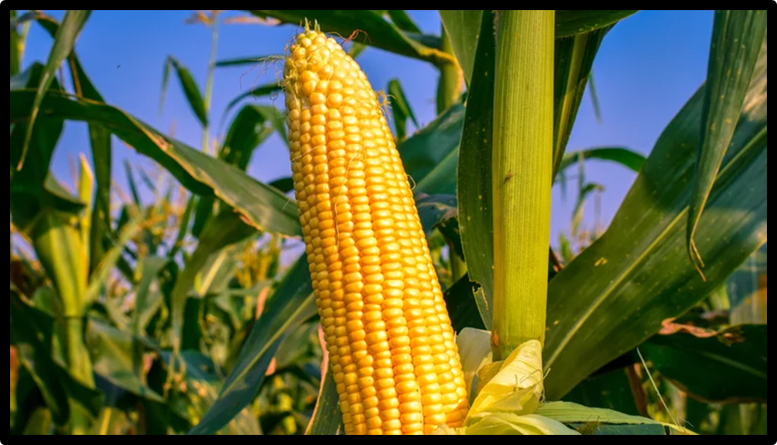
Source:FutureSource

Slide 10
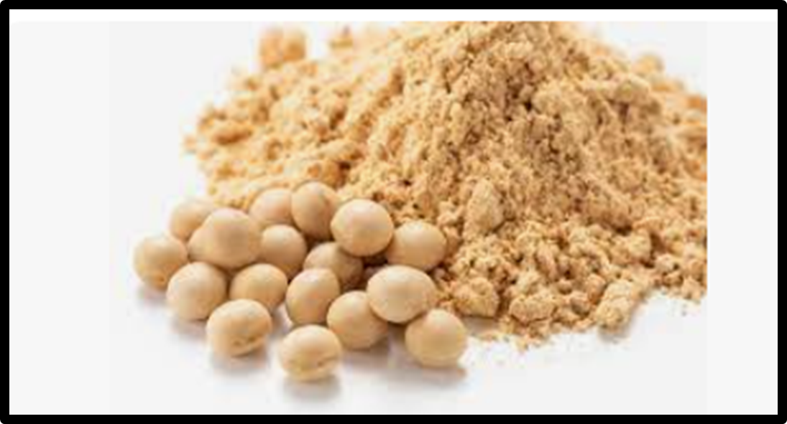

Slide 11
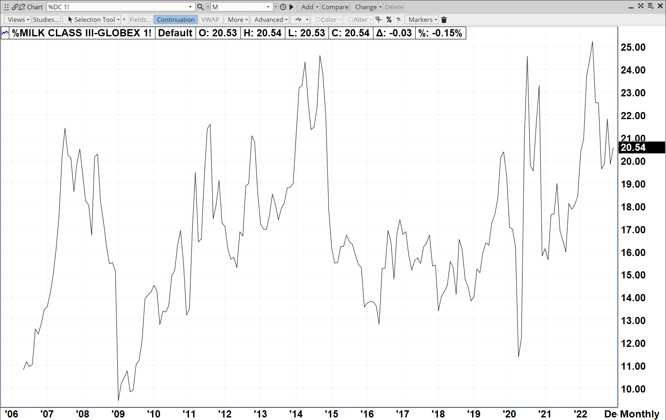
Source:FutureSource

Slide 12
Key Commodity Market Principle/Concept
Price is not Random
Price is not fixed, set, or mandated
Price is discovered. Buyers and Sellers, both emotional “basket cases” meet and nervously agree to a price.
Prices relate one to another
Price has patterns of “Behavior” trends, consolidation, cycles, seasonal direction,

Slide 13
Price has Behavior…….
2023 May Cotton Futures
Weekly Price History
Source:FutureSource

Slide 14
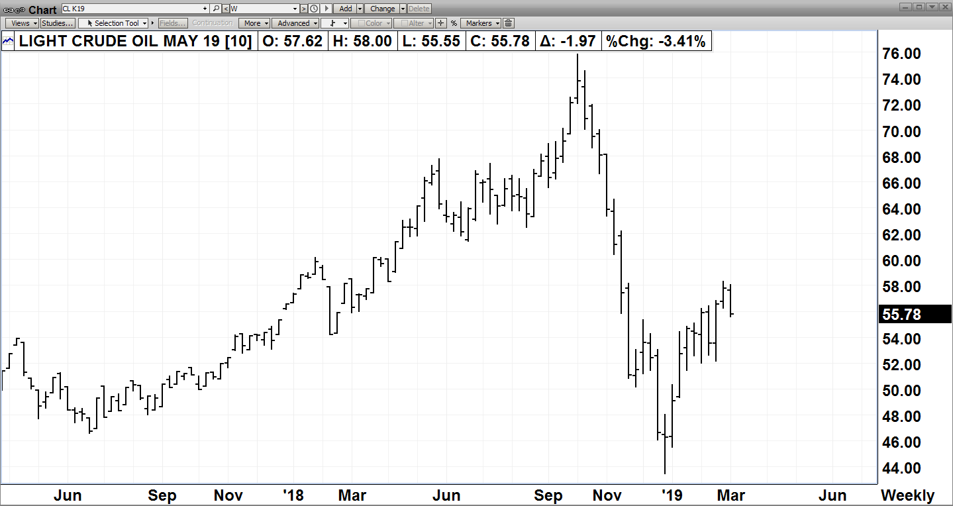
Price has Behavior….
Source; FutureSource

Slide 15
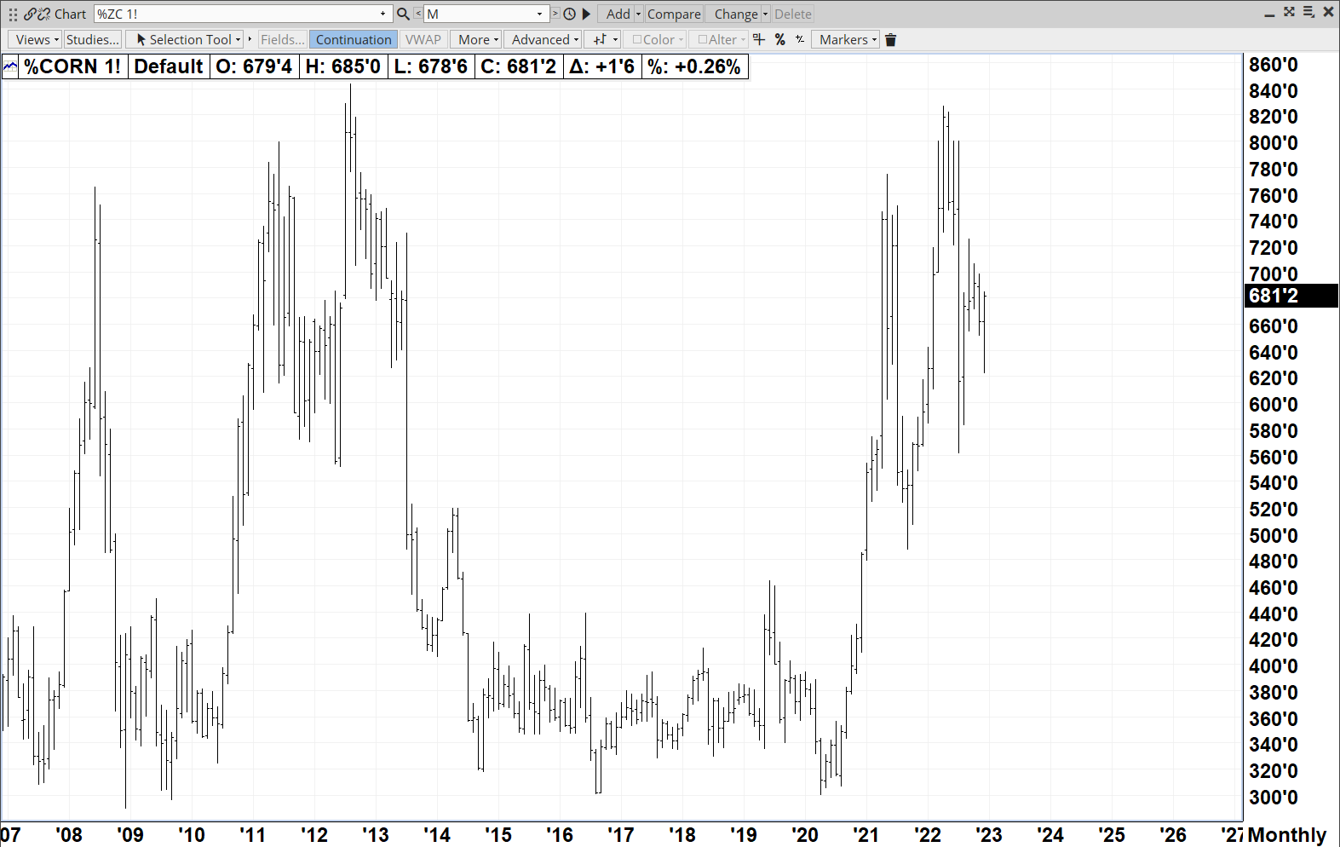
Commodity Market Prices have Behavior
Source:FutureSource
What Next
?

Slide 16
Patterns of the Past Repeat Themselves
Monthly Continuous Corn Futures Price Chart
?
Source:FutureSource

Slide 17
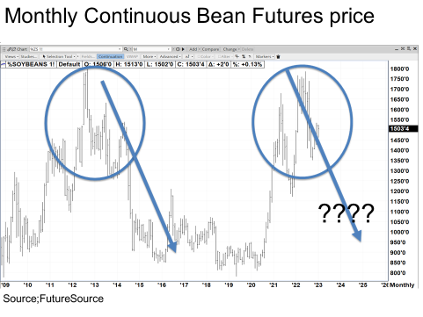

Slide 18
SEASON PRICE PATTERN
Buy Zone

Slide 19
SEASON PRICE PATTERN
Buy Zone
Buy Zone

Slide 20
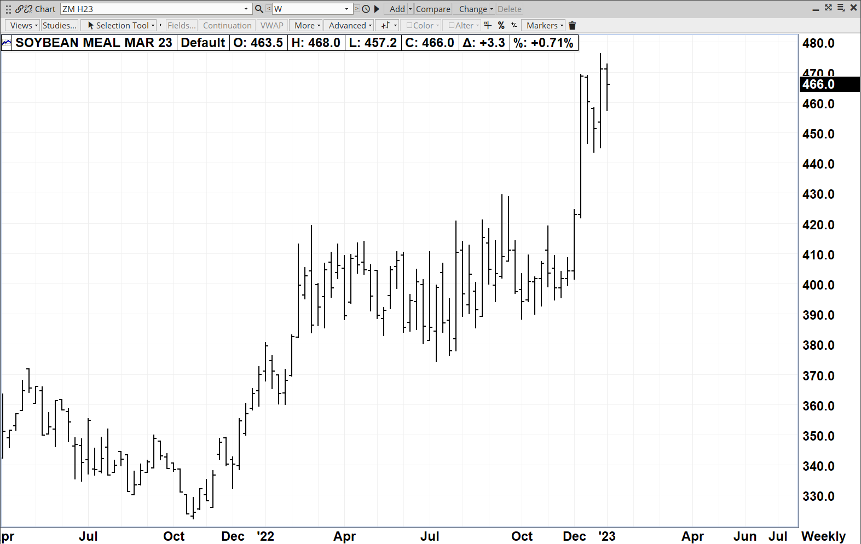
Seasonality???
First Market Consideration
Trust Required
Buy Zone
Buy Zone
Source:FutureSource

Slide 21
SEASON PRICE PATTERN
Sell Zone

Slide 22
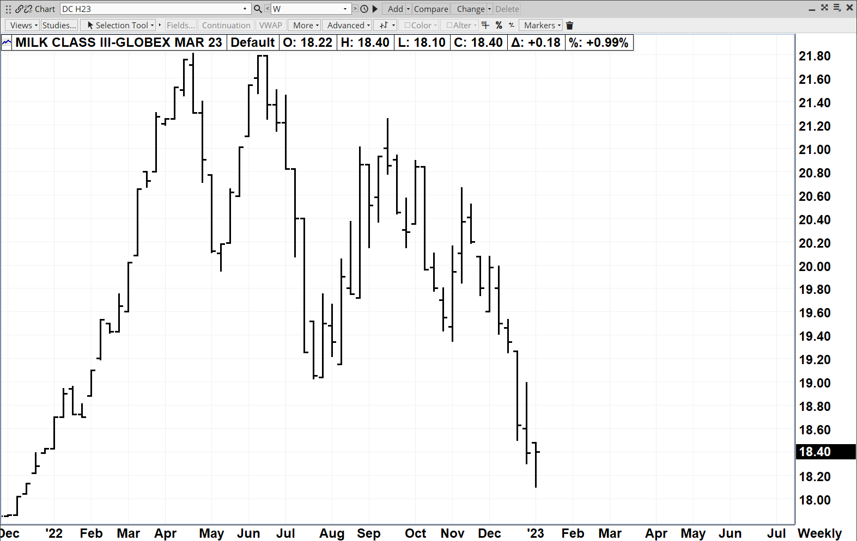
Seasonality???
First Market Consideration
Trust Required
Sell Zone

Slide 23
3 year Milk Price Cycle
Source:FutureSource

Slide 25
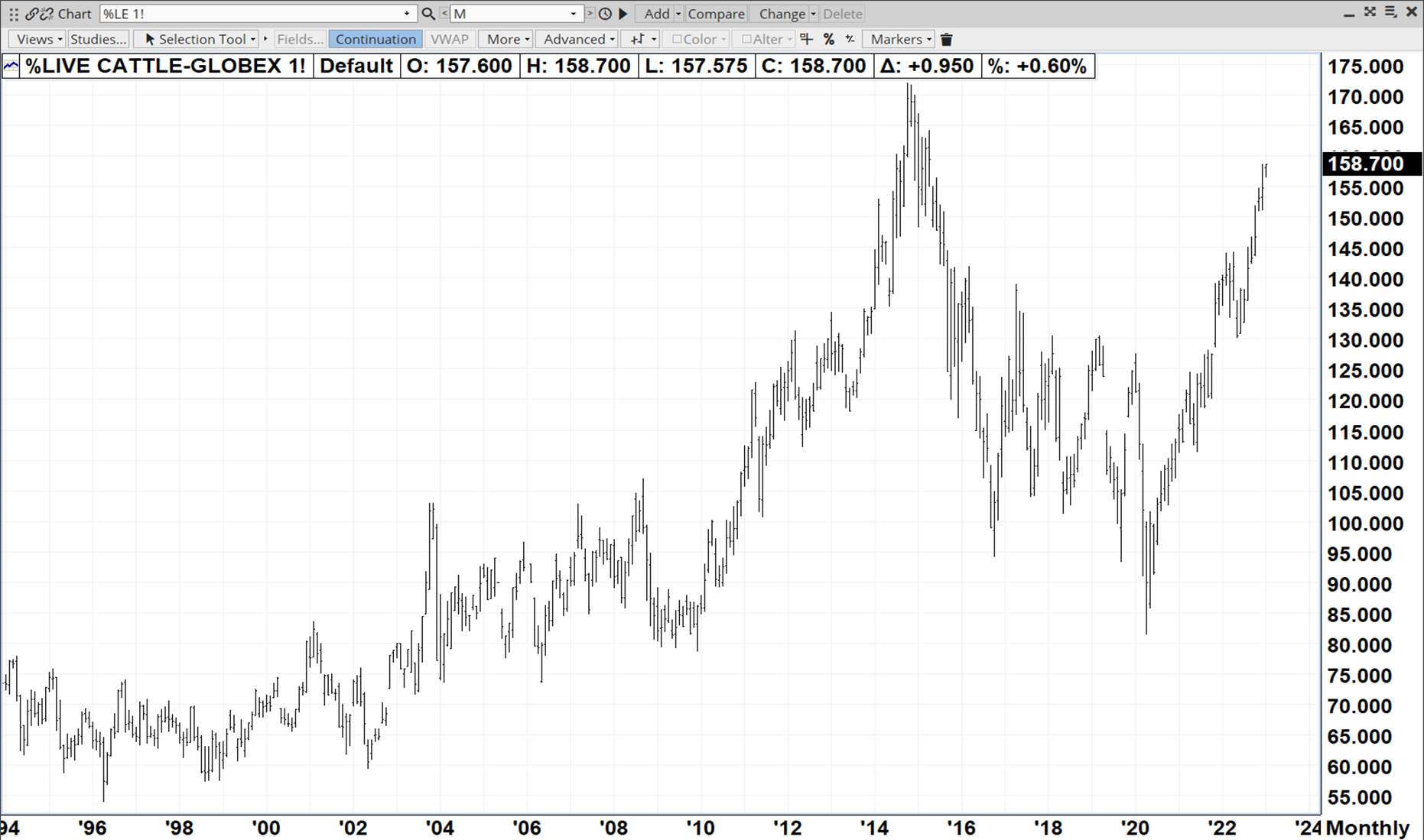
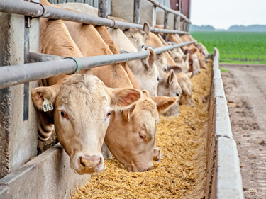
10 year Cattle Cycle

Slide 26
Key Principle/Concept
Nobody knows where the Price is going
But everyone should know where Price
Could go. Acknowledge Risk

Slide 27
$8.00
Price Risk

Slide 28
$540
$490

Slide 29
$16.00
2023 Seasonal Price risk
3 year Price Cycle risk 2024

Slide 30
Class Pricing
$18.80
$17.00
Sub $15.00

Slide 31
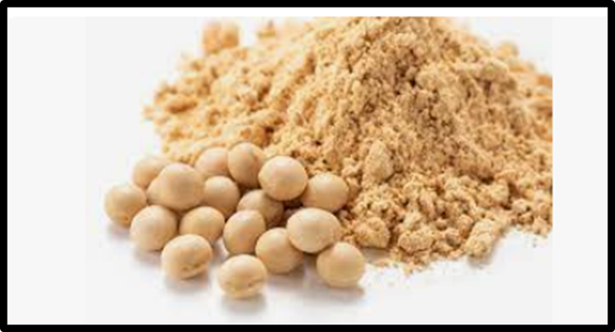
Your Price Risk
$8.00
$550
$15.00

Slide 32
What is Marketing ?
MARKETING:
Efforts involved in pricing and or protecting price of commodities in advance of their production or use.
“Doing Something with Price”
For Dairy Net Margin is 62% dependent on Markets

Slide 33
Observed Characteristics of Successful Marketer
Fully Acknowledging Price Risk forward
Have a written management approved Plan/Policy/System
Forward Modeled Price/Revenue/Margin drive Strategy
Have Funding/ Budget for marketing action.
Employ consistency/decisiveness/systematic approach
Successful Marketer
Never “Doubts” a market

Slide 34
Our Approach is PRINCIPLES based..
We focus on Price currently offered not what we hope it to be.
We admit to not knowing where price is going
We acknowledge Price Risk as it applies to each client
We appreciate Price Patterns of Behavior
We are not surprised that Prices go up Prices go down
Risk is framed around Price going back to where it came from
We coach clients through Marketing Plan development
We understand Marketing requires Funding/ Budget
Price/Revenue/Profit drive Strategy
We promote Systematic Market action consistency/decisiveness
We Never “Doubt” a market

Slide 35
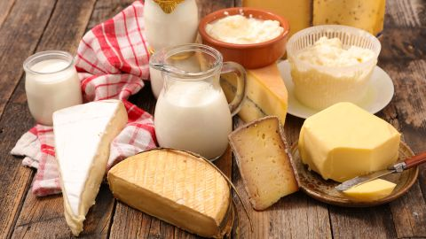
Dairy’s Future is Very Bright
Milk Nutritious and Safe
Milk can be processed into
wide variety of products
Dairy Production and Processing
infrastructure is highly developed
Technology continues to develop through out industry
Dairymen can leverage their comparative advantages
Mature Markets and Marketing Tools are available.

Slide 36
Conclusion
Accept Challenge of Managing Price Risk
And Price Opportunity by
Employing Commodity Marketing Principles, Concepts, and Tools.
Have Fun !!!!!
Thank You
Georgia Dairy Producers

Slide 37
Atten Babler Commodities Atten Babler Insurance Services 1800-884-8290
We stand ready to be a resource to your Dairy.
Carl Babler
cbabler@attenbabler.com
Direct Number 815-402-3859

