Slide 1

Re-thinking Rotations to Maximize digestible fiber
Daniel Olson – Forage Innovations

Slide 2


Slide 3
Dairy rations have 3 primary energy sources
Starch
Sugar
Digestible Fiber

Slide 4
How do you identify digestible fiber?
NDF -
NDFD30
dNDF30
uNDF240

Slide 6
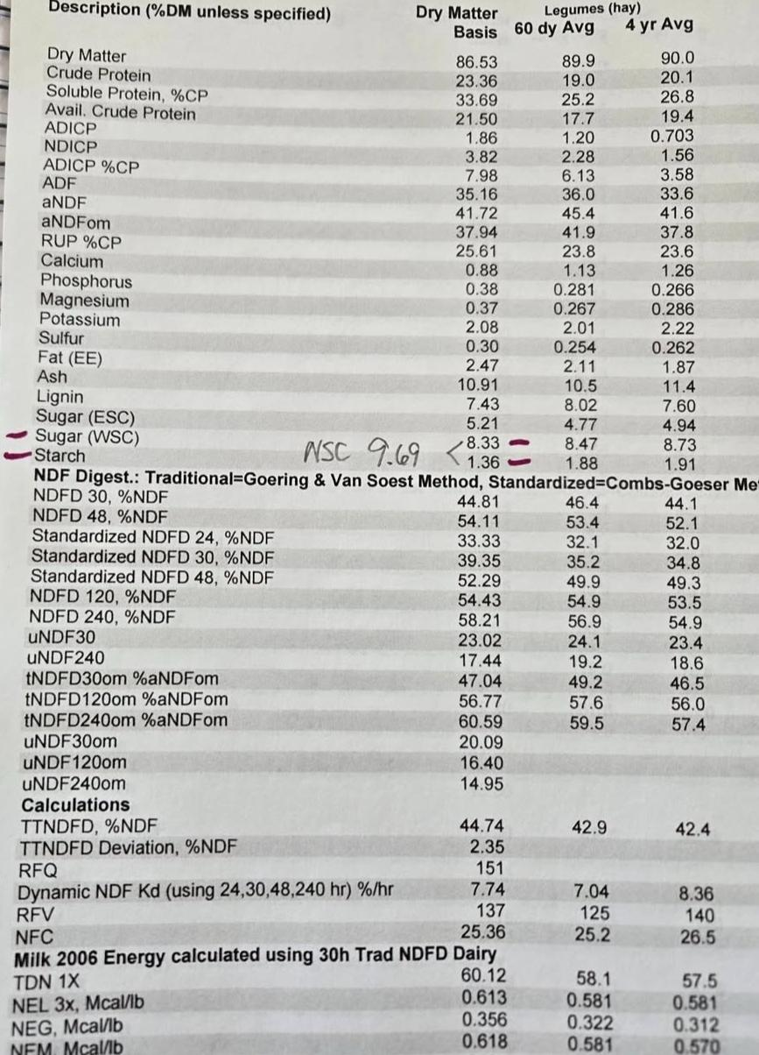
NDF 41.72%
NDFD30 44.81%
dNDF30 18.7%

Slide 7
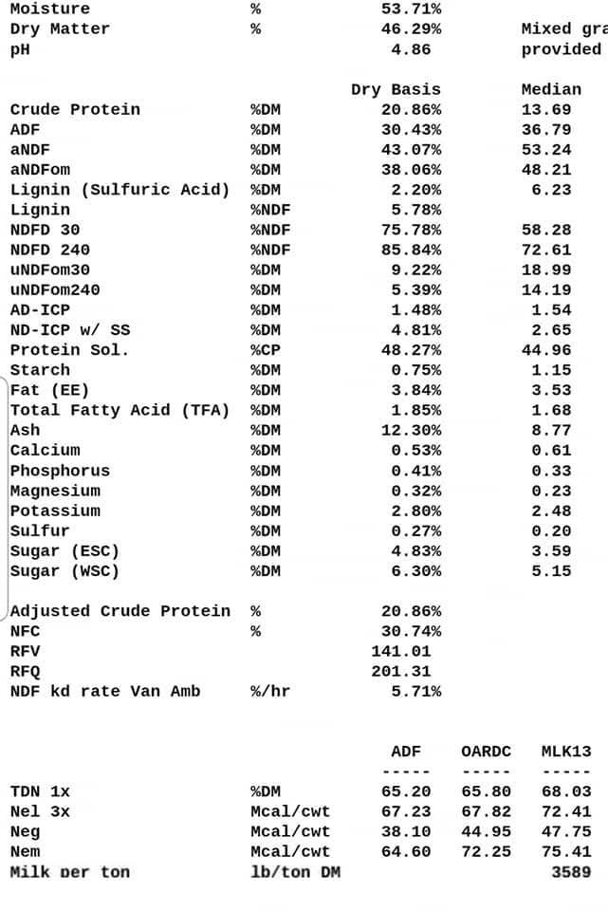
43.7% NDF
75.78% NDFD30
= 33% dNDF30

Slide 8
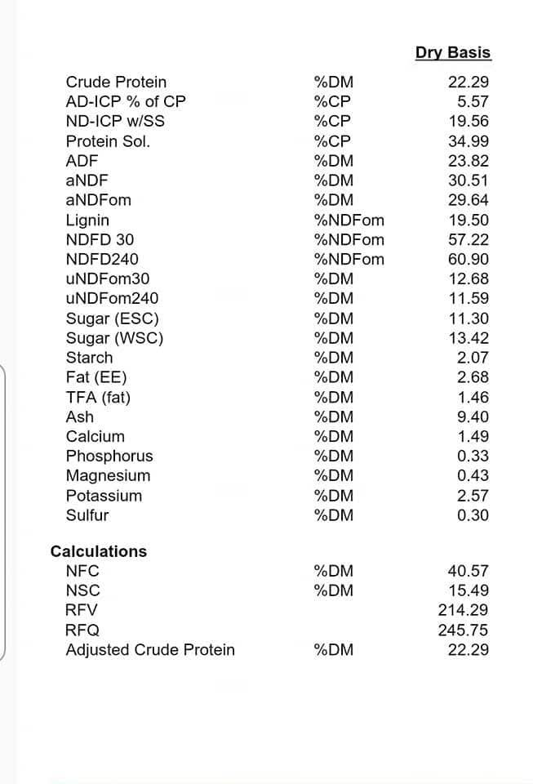
NDF 30.51%
NDFD30 57.22%
dNDF30 17.45%

Slide 9
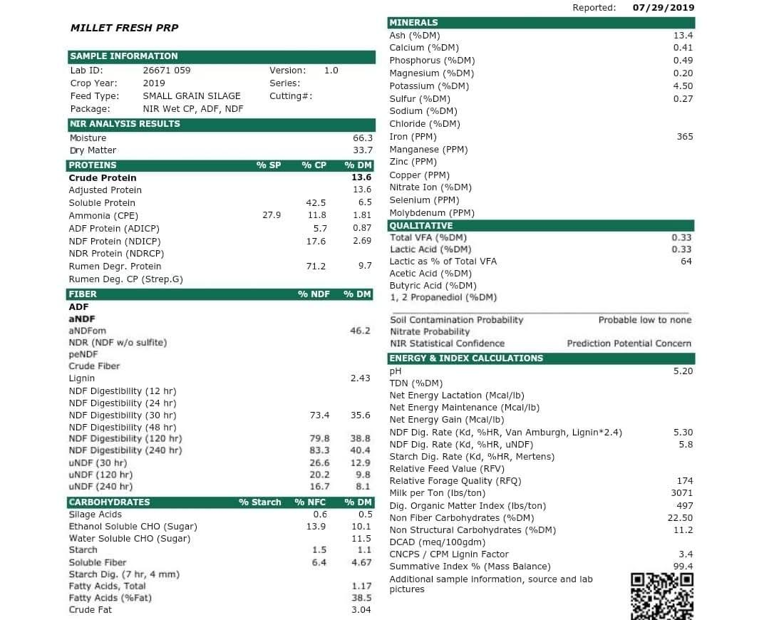
NDF 46.2%
NDFD30 73.4%
dNDF30 33.91%

Slide 10

“Normal” Crop Rotation

Slide 11
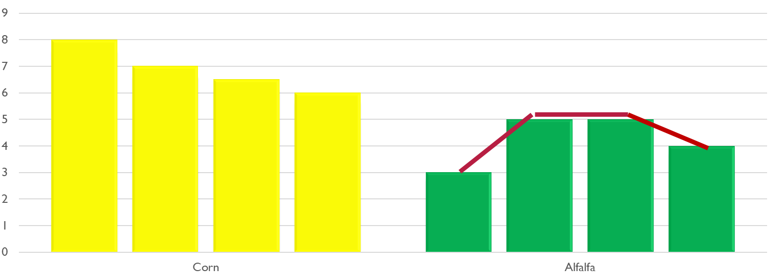
Rotation Comparison
Corn-Alfalfa Rotation
Corn/Trit/Annual Rotation

Slide 12
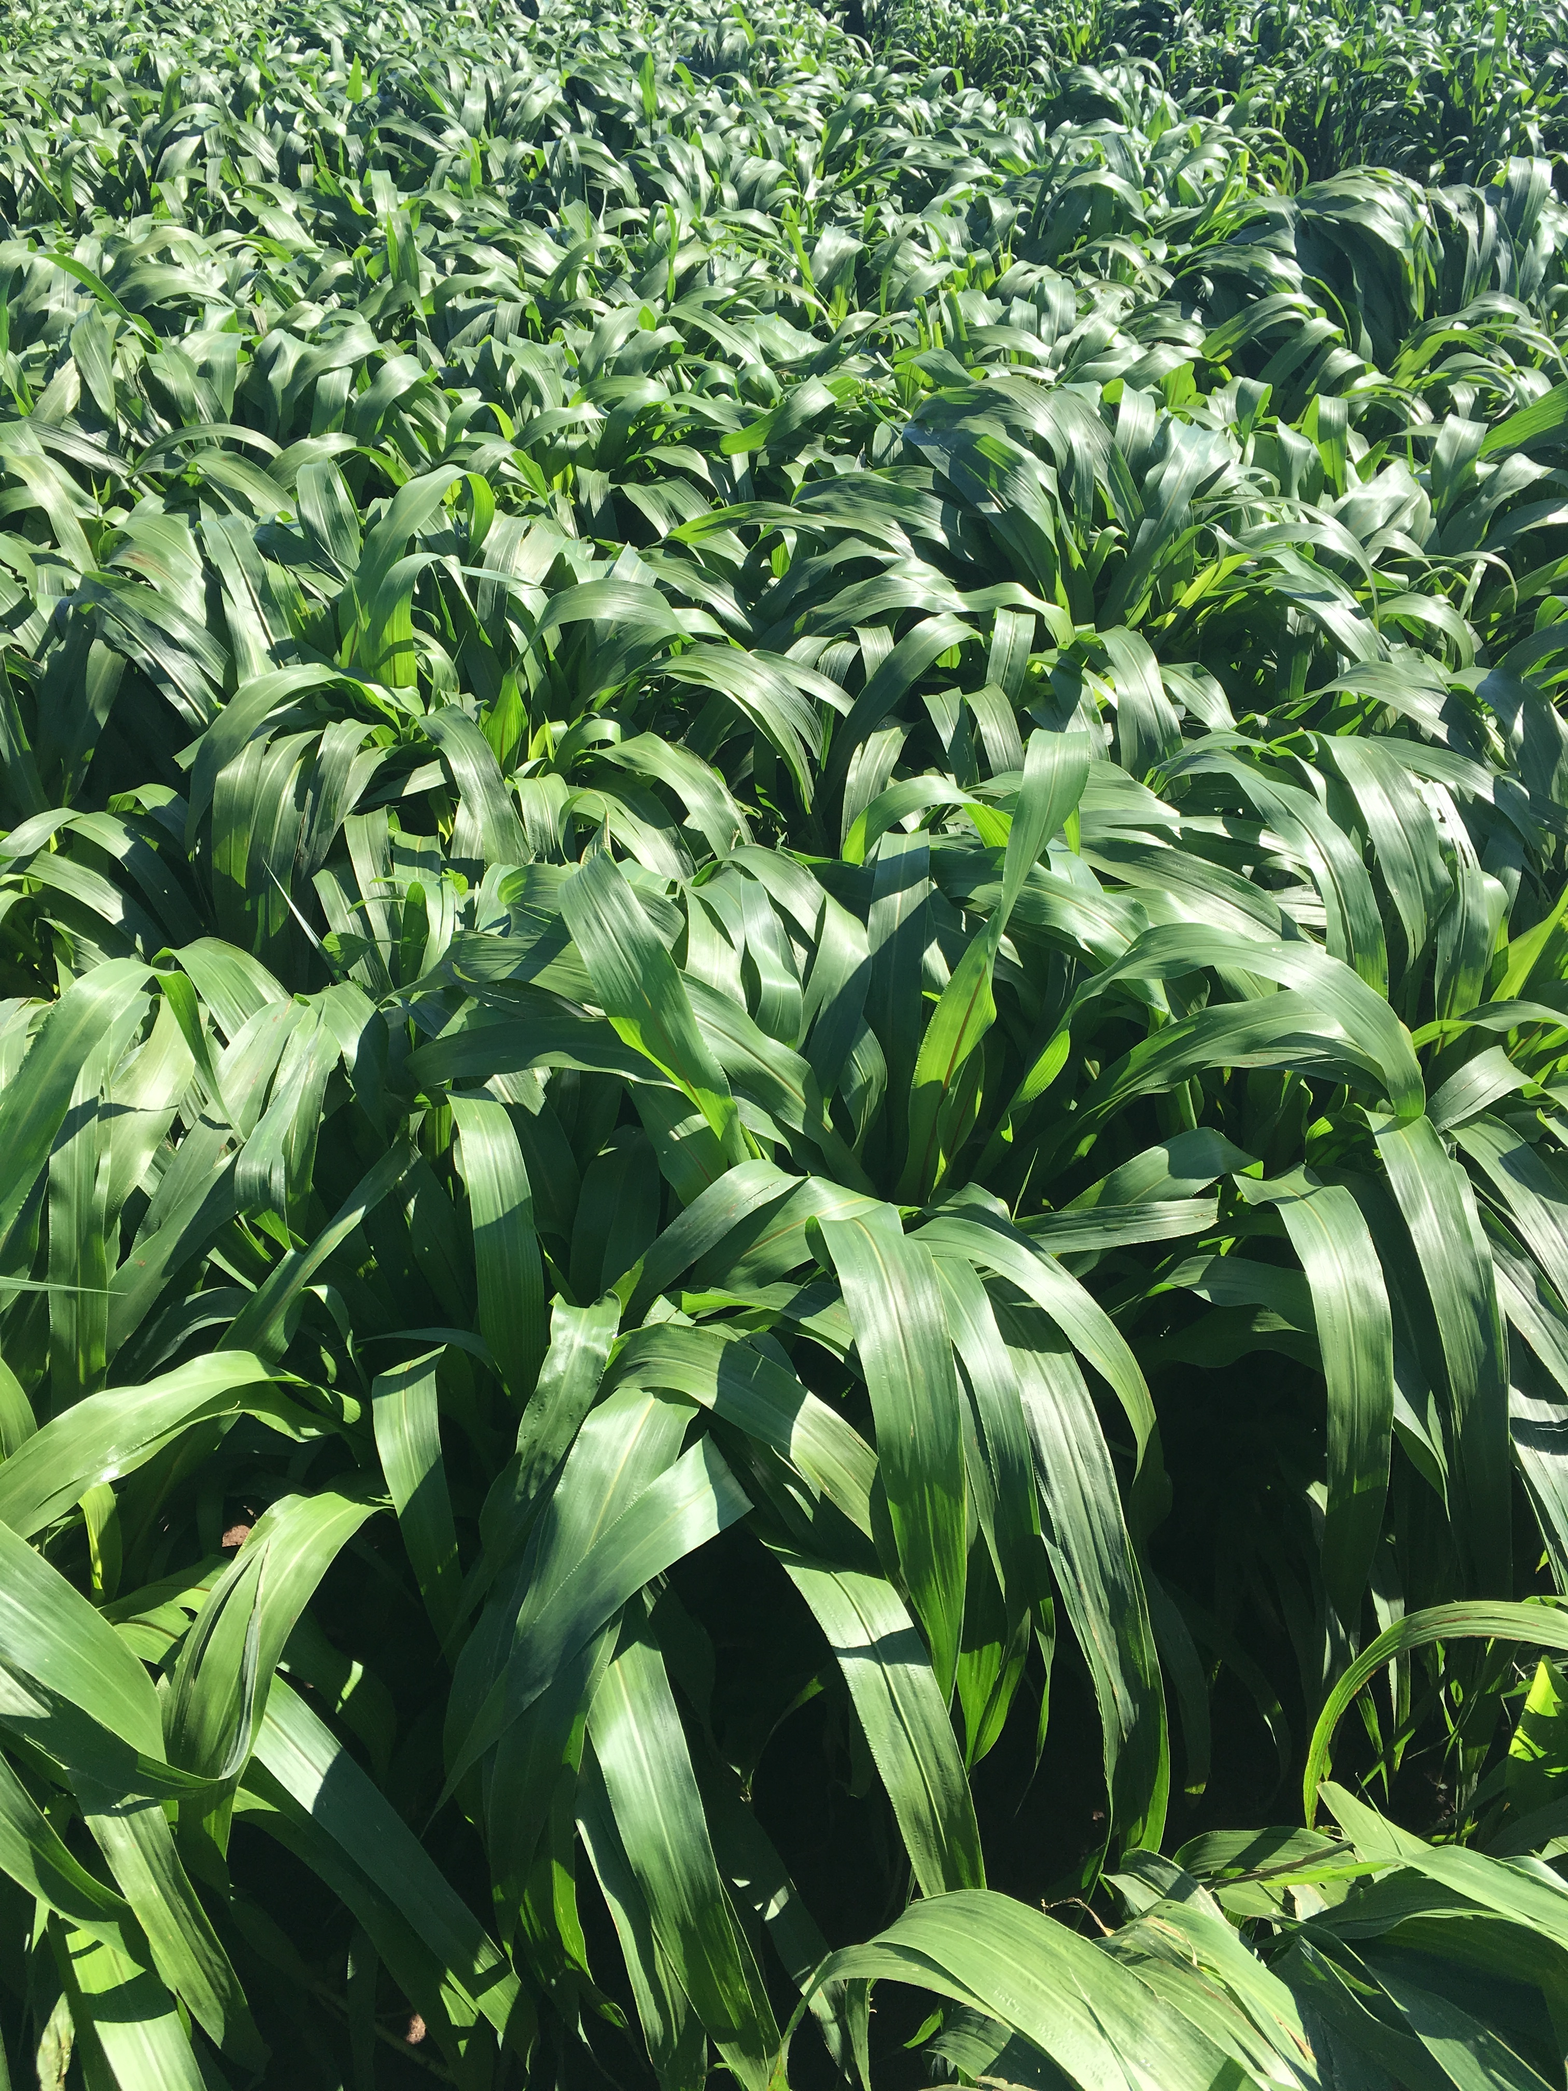
BMR Pearl Millet
Incredible digestibility
Aphid resistant
Low uNDF240
Multi-cut

Slide 13
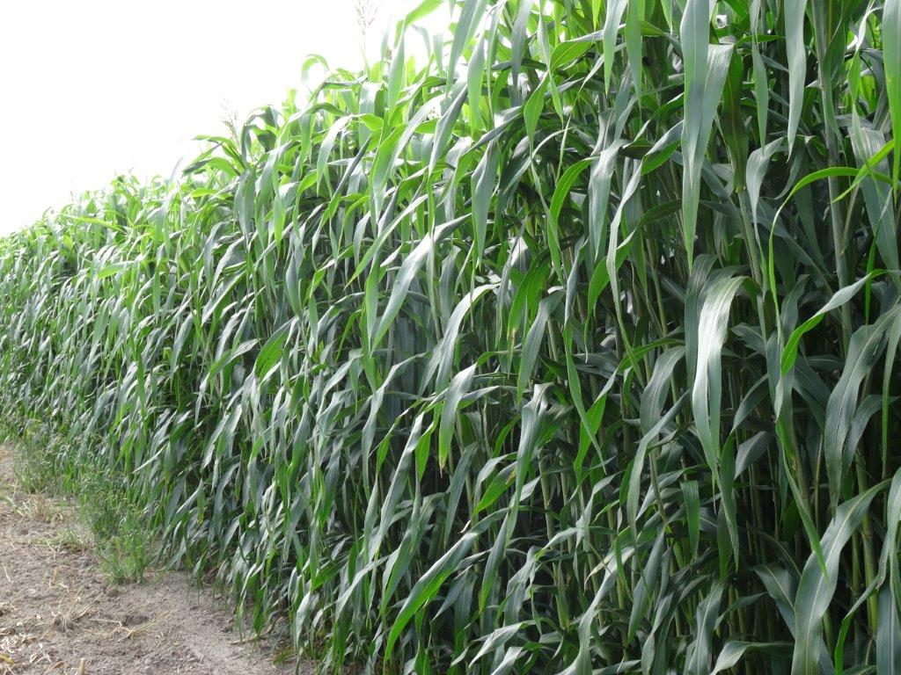
BMR Forage Sorghum
Single cut
Large amounts of digestible fiber.
Some aphid tolerant varieties [but dwarf about a year away]

Slide 14
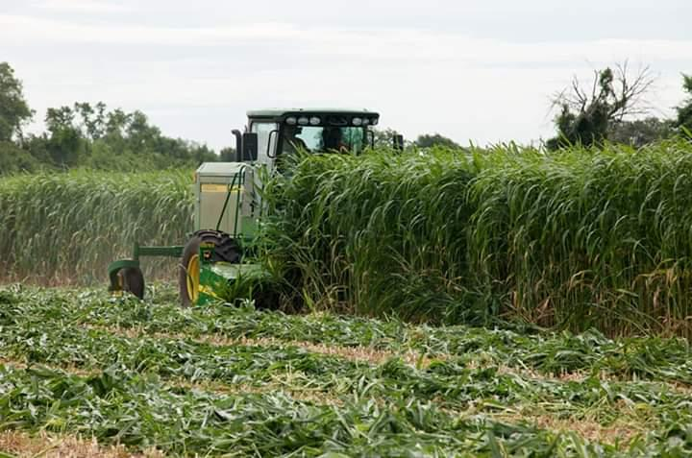
PPS BMR Sorghum Sudan
Single or multi-cut
Aphid tolerance
Exciting, new dwarf, sterile variety.
Great digestibility

Slide 15
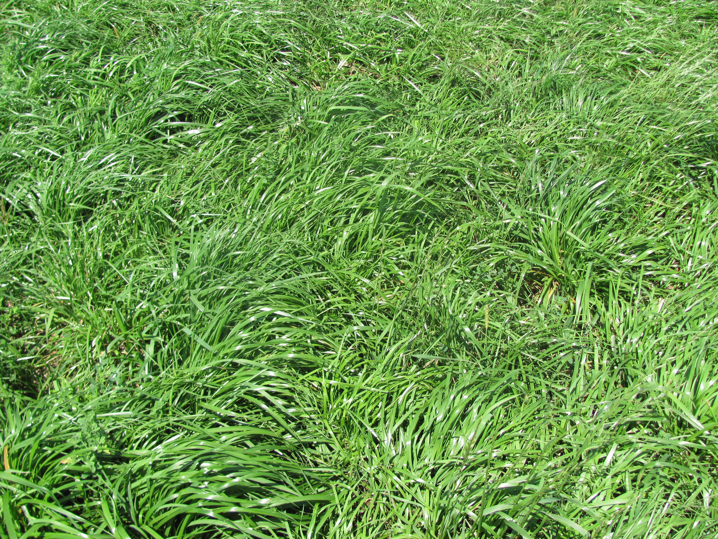
Annual Ryegrass
New European Genetics
Diploid vs Tetraploid

Slide 16
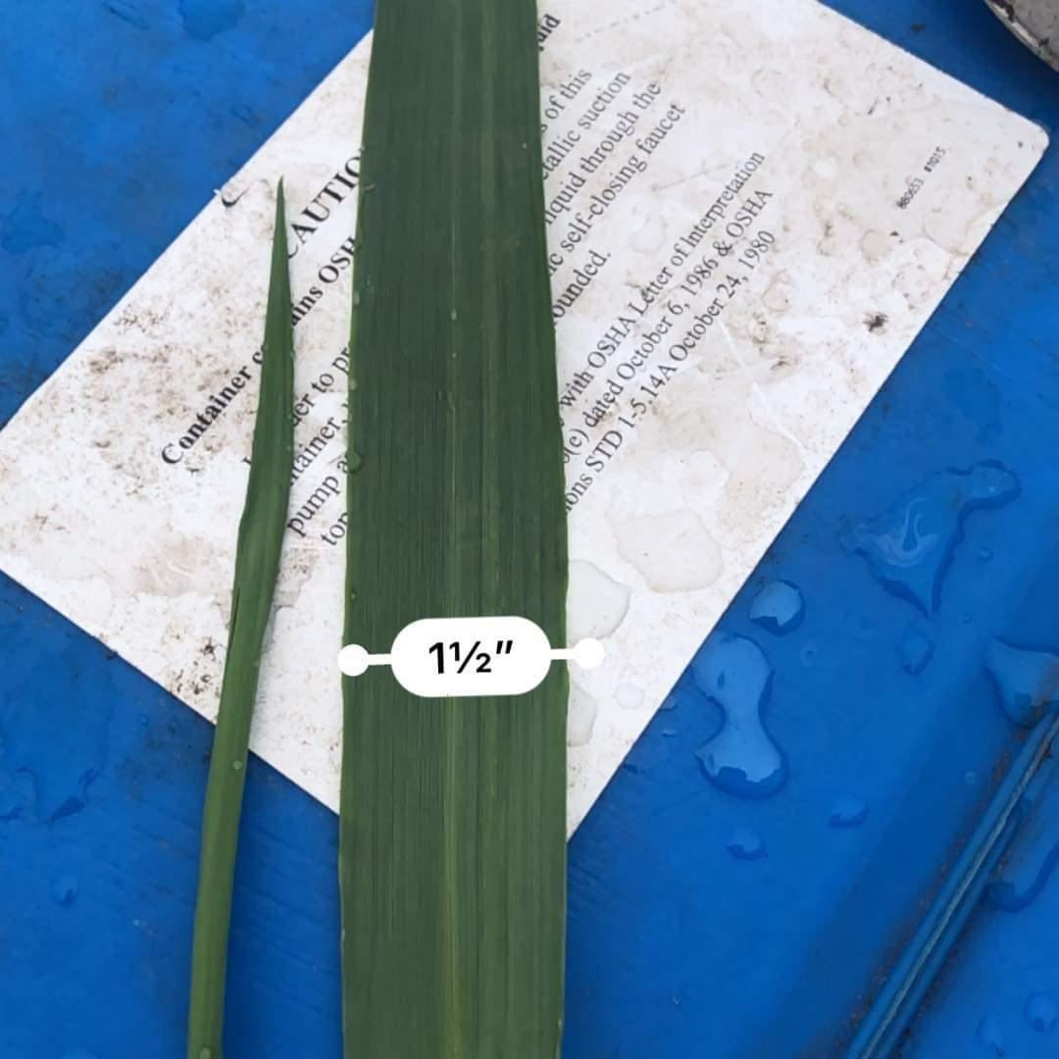
Forage Oats
Larger fiber pool
Greater fall yields
Works well with ryegrass

Slide 17
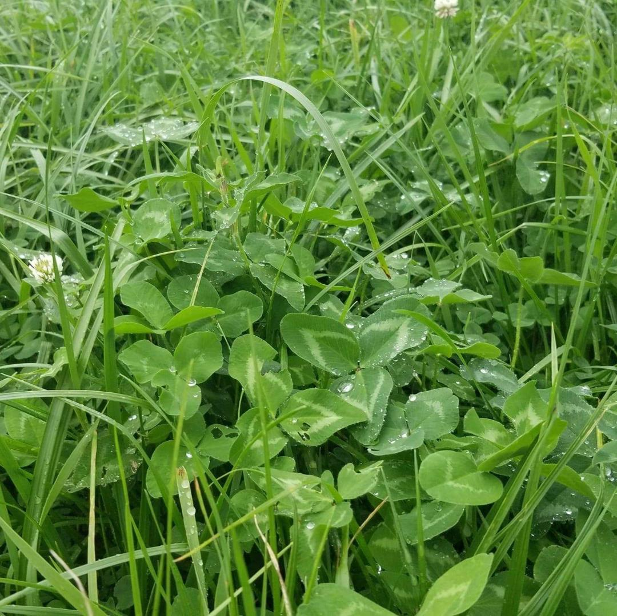

Slide 19
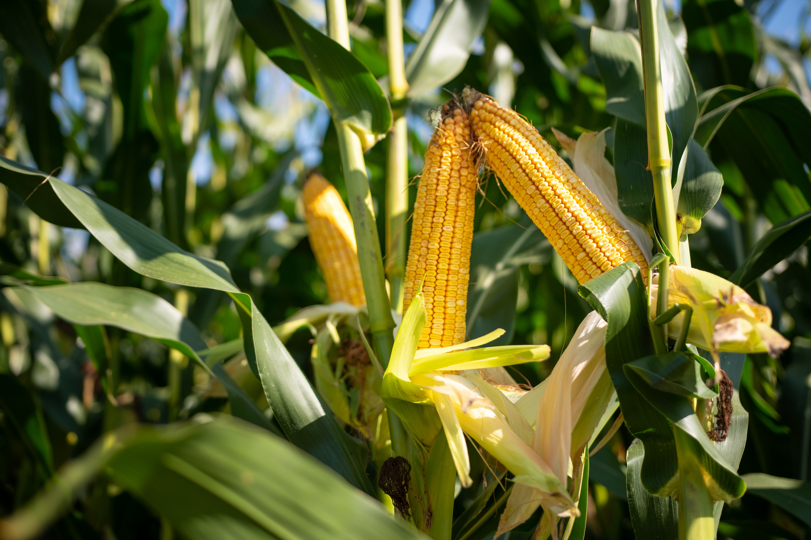

Slide 20
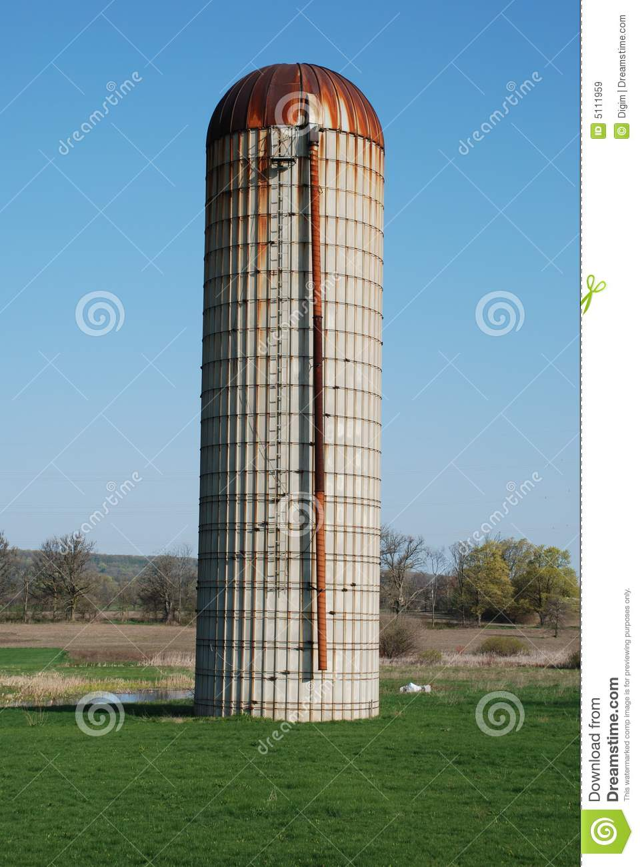
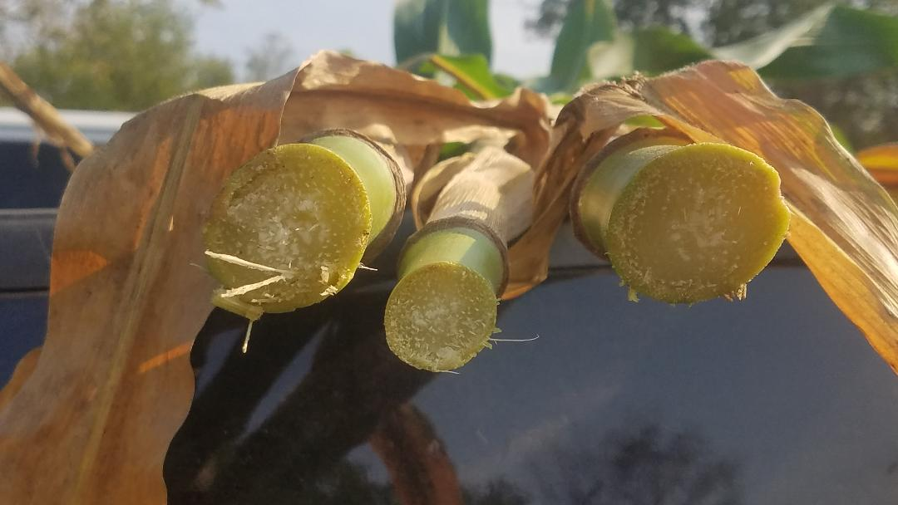
Why does it work?
Stalk Expansion

Slide 23
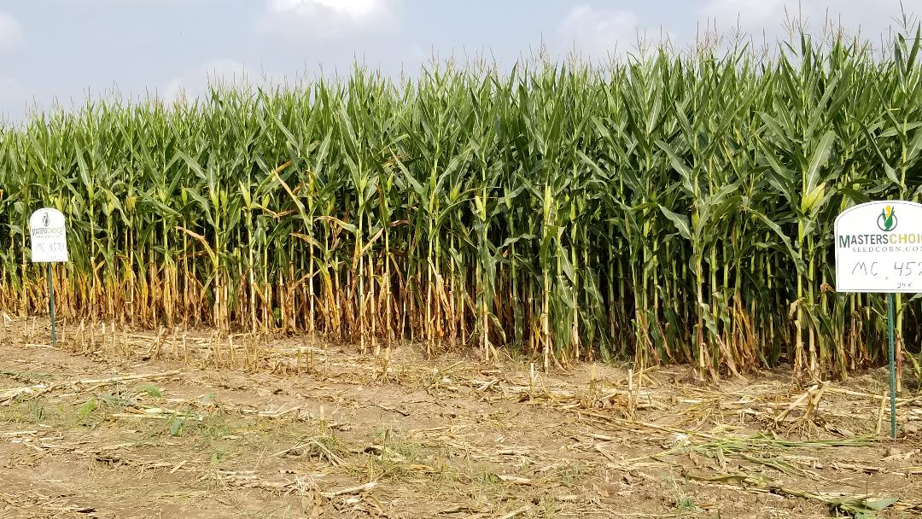

Slide 24
How do you get stalk “expansion” ?
Spacing
Genetics
Fertility

Slide 25
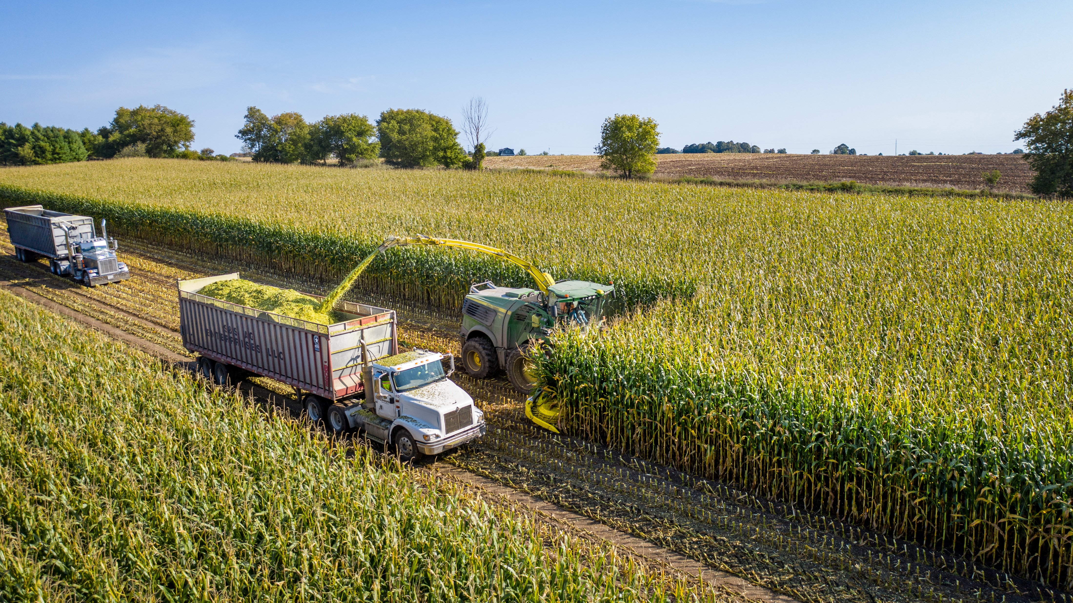
How do you get stalk “expansion” ?
Questions? Daniel@forageinnovations.guru
www.forageinnovations.guru
Spacing
Genetics
Fertility

